Slide 1

@Ericsls
Hogeschool ICT

Slide 2
Anything in IT!
The challenge

Slide 3
Education should happen in context

Slide 5









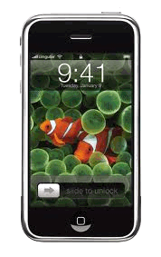





























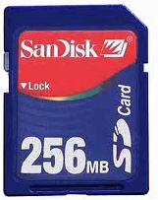















2002
2004
2006
2008
2010
2012
2014
2015
2016
2017
Hogeschool ICT

Slide 6
We’re educating for unknown
future challenges!

Slide 7
We’re educating for unknown
future challenges!
The need for responsive professionals

Slide 8
Can we educate for tomorrow
with yesterdays educational systems?

Slide 9
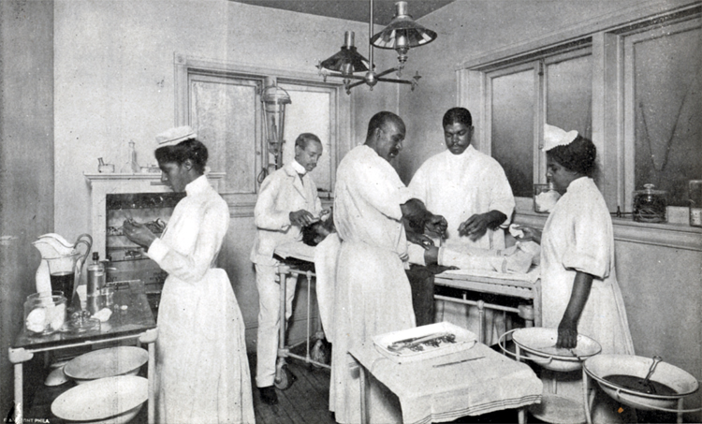

Slide 10

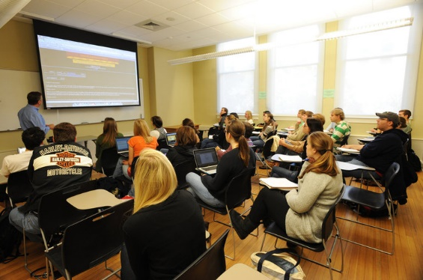
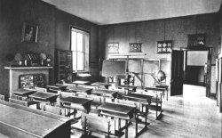


Slide 11
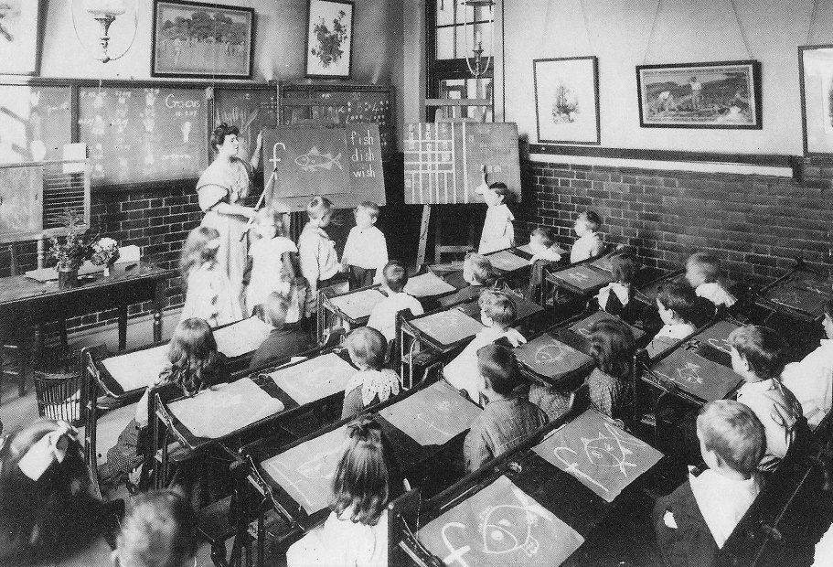
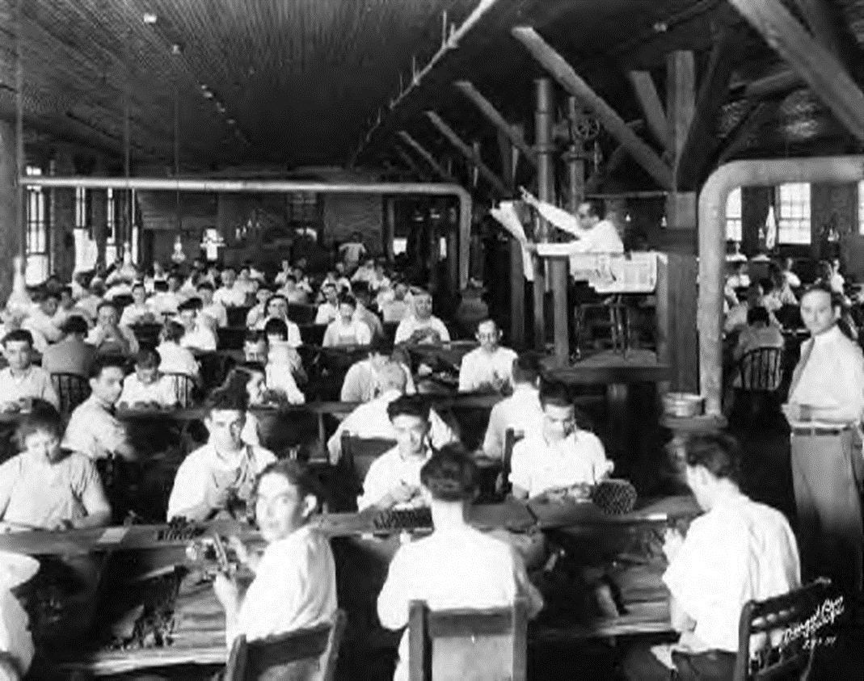
Mass production of knowledge

Slide 12
Current date is Tue 1-01-1980
Enter new date (mm-dd-yy):10/04/17
Current time is 0:11:08:87
Enter new Time 3:33:43
The IBM Personal Computer DOS
Version 1.00 (C)Copyright International Business Machines Corp 1981, 1986
(C)Copyright Microsoft Corp 1981, 1986
A>
A> Context change is exponential!
A>
A>
A> cd \current_state\impact_on_learning
_

Slide 13

2010

Slide 14
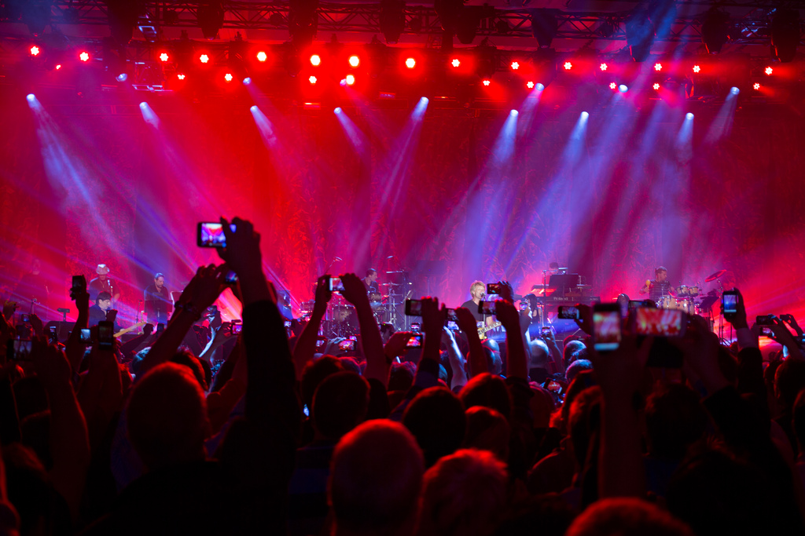
2015
Personal IT has arrived FAST!

Slide 15
Information has become
a commodity

Slide 16


Slide 17











Slide 18









Slide 19
















Slide 20








Notes:
Hybride leren Bouwsteen #4

Slide 22
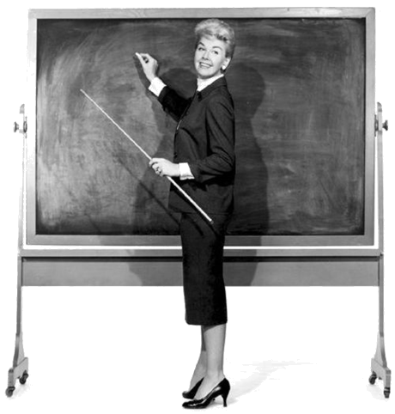

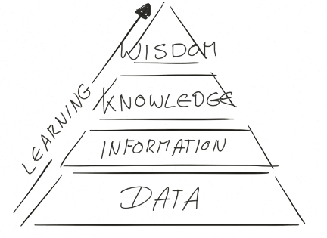
information
sharing
Formerly known as education is over

Slide 23
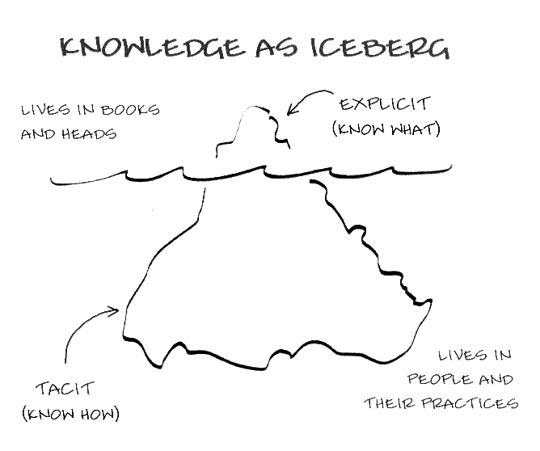

A chance for change!
Notes:
KAL, Betekenisvolle context
#4 Hybrid learning
#3 Cooperation interaction and coaching (Betekenisvolle dialoog en coaching)

Slide 24

Change ?
Content
Tempo
Level
Style
Data
Didactics
Notes:
#2 Selfmanagement (ownership)
#4 Hybrid learning (Anything goes)
#5 Actie en deling (Betekenisbvolle context, Activated learning)\
#6 Flexibile leerruimte (Felicibility)

Slide 25
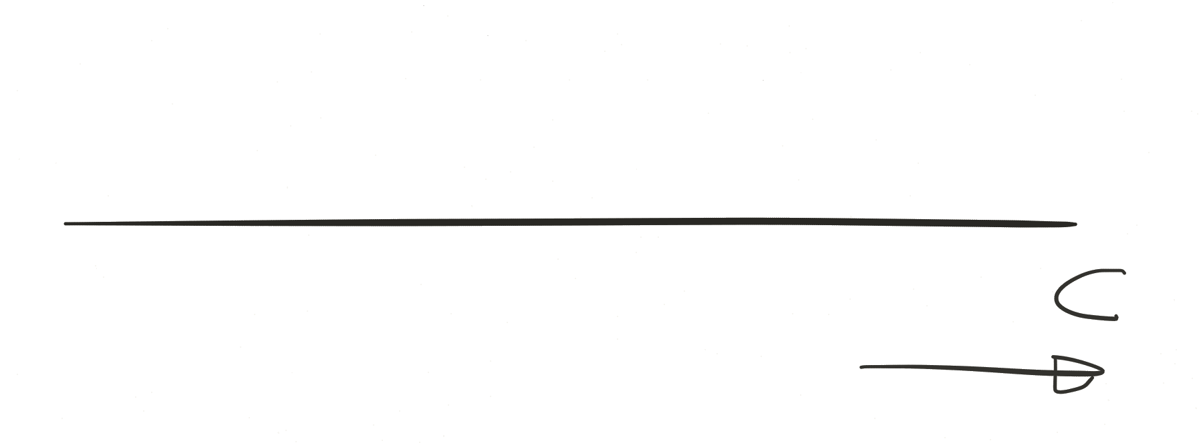
Competences describe context!

Slide 26
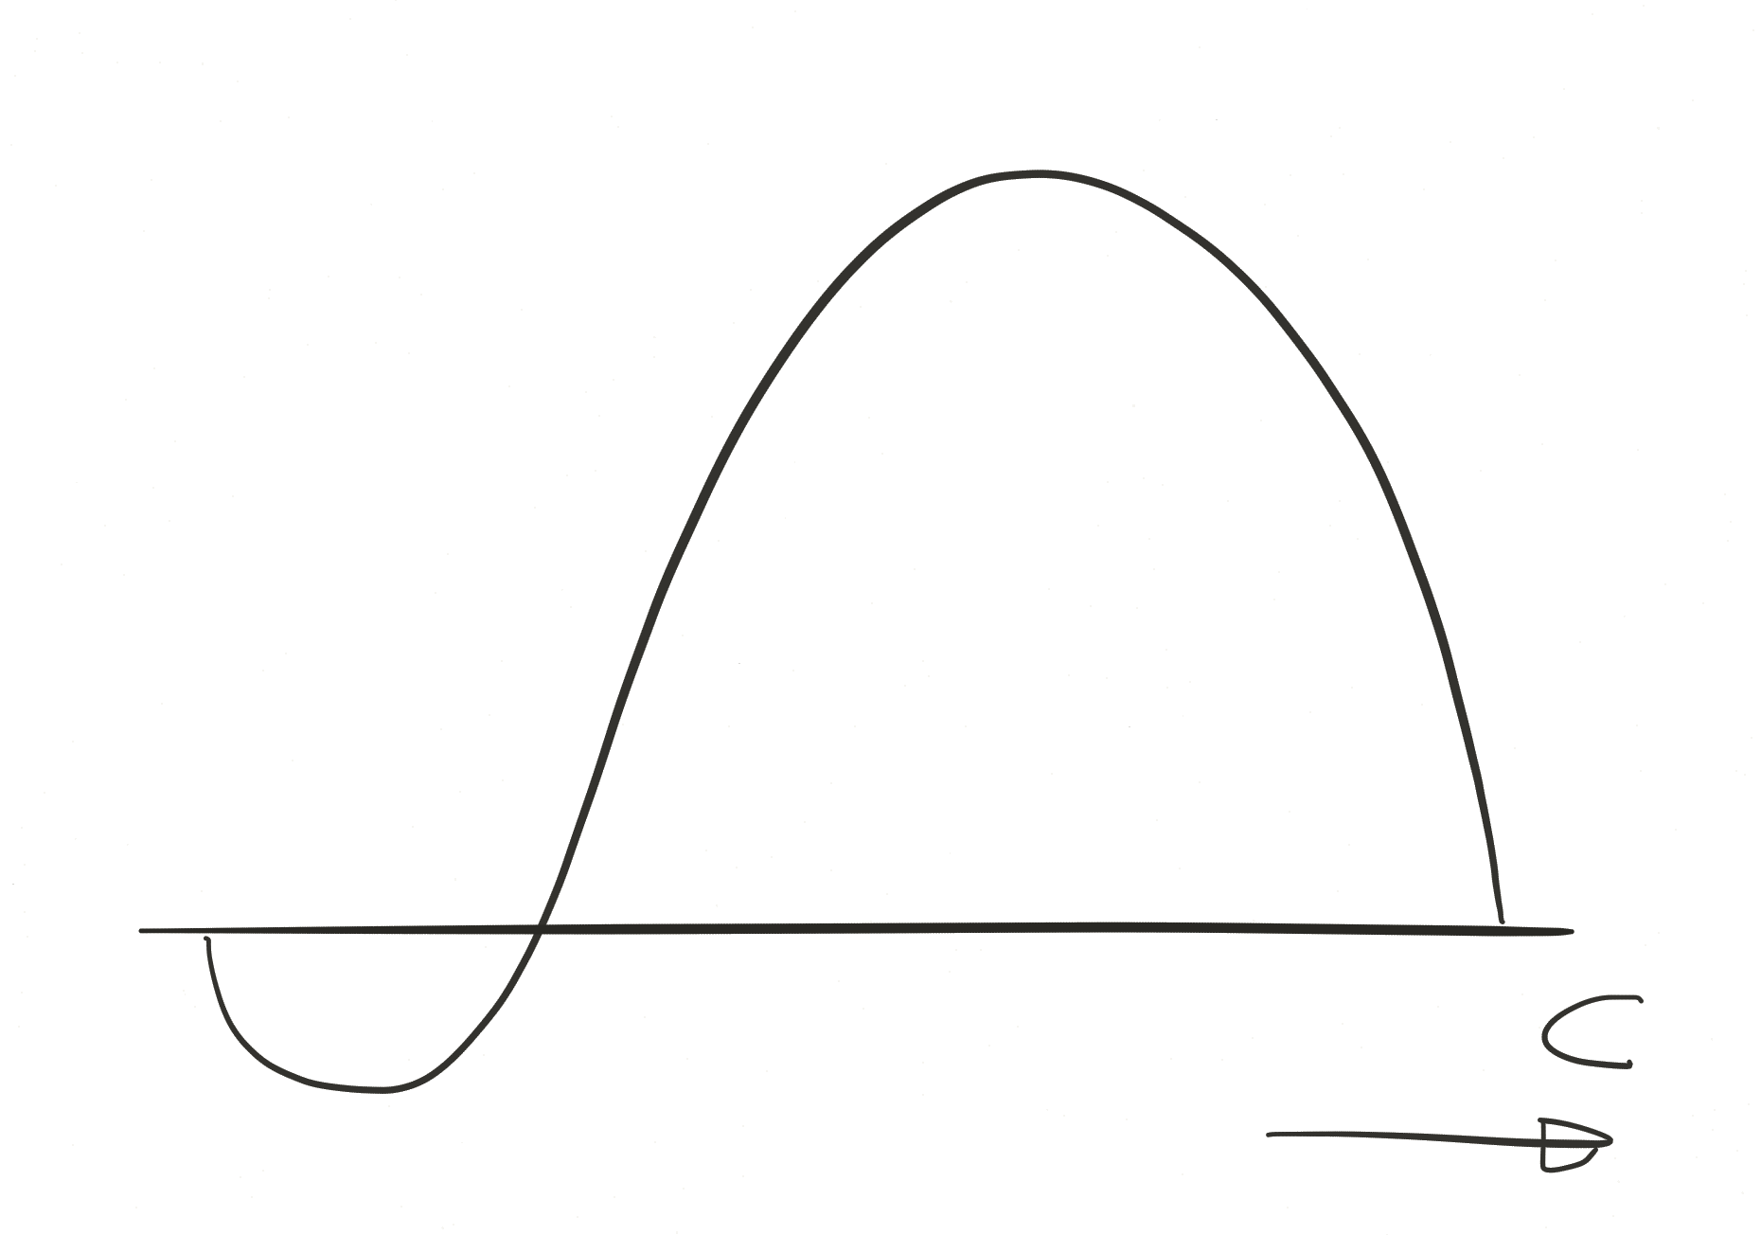

Slide 27
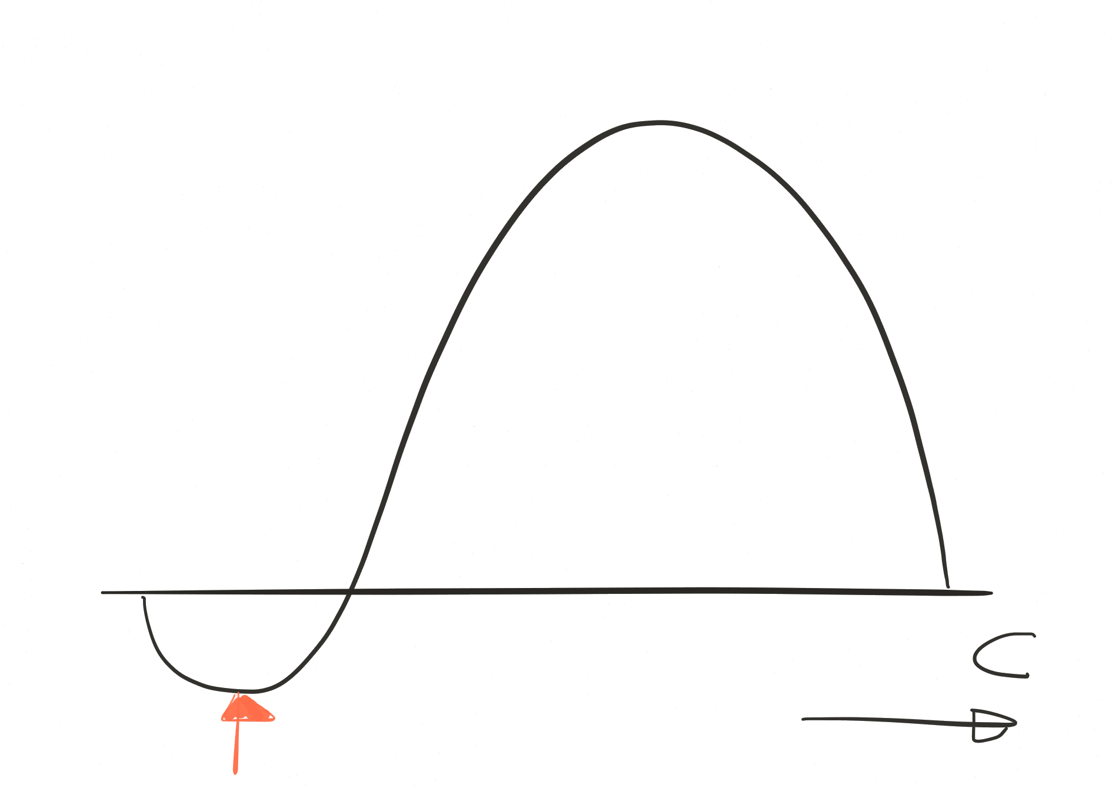

Slide 28
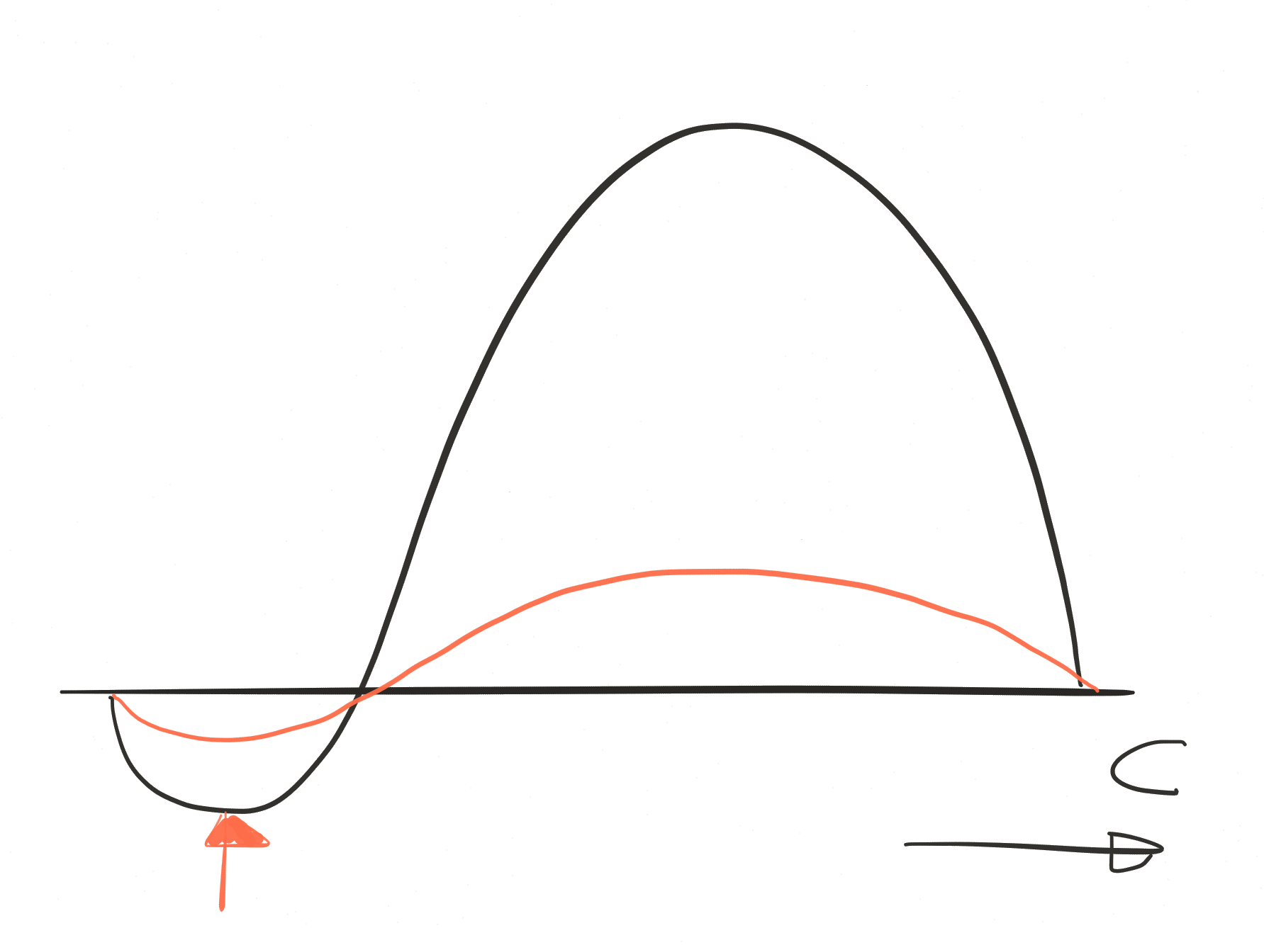

Slide 29
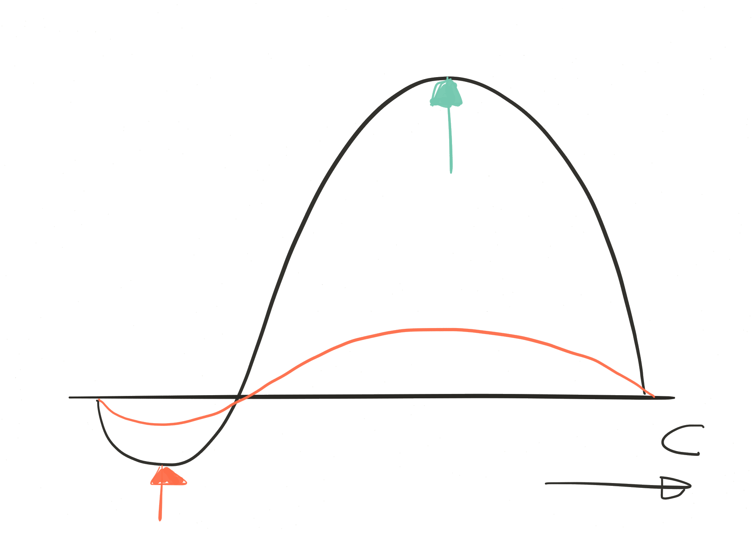

Slide 30
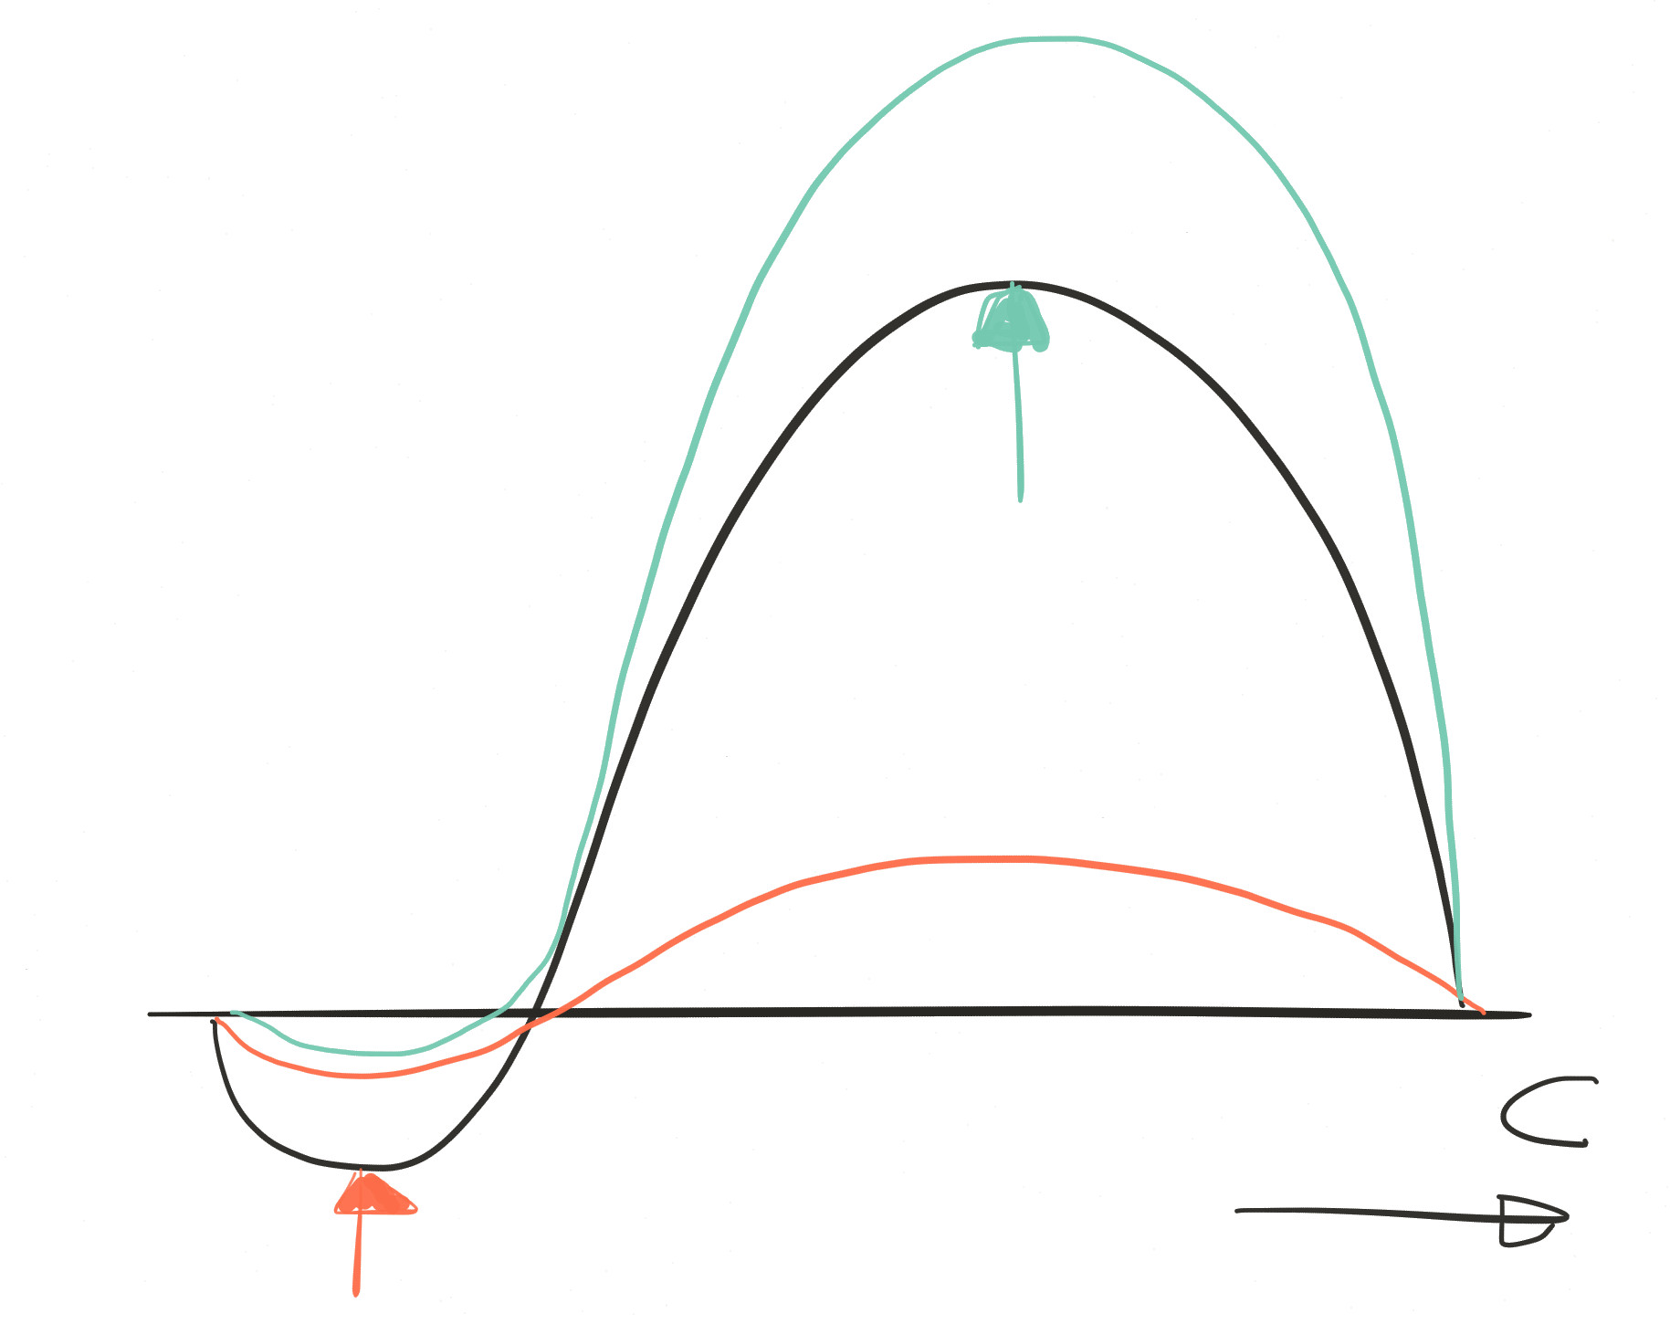

Notes:
D

Slide 31
HOW?
Content
Tempo
Level
Style
Data
Didactics
Notes:
#2 Selfmanagement (ownership)
#4 Hybrid learning (Anything goes)
#5 Actie en deling (Betekenisbvolle context, Activated learning)\
#6 Flexibile leerruimte (Felicibility)

Slide 32



What
Personal Dynamic Competence Profile
Hogeschool ICT
Notes:
#1 Urgentie Hiaat Probleem (Why learn)
#2 Selfmanagement & Learning Agenty (Eigenaarschap en autonomie)

Slide 33



What
Personal Assignments (with partners)
Hogeschool ICT

Slide 34



What
Personal Criteria (level good)
Hogeschool ICT
Notes:
Zelfsturing

Slide 35
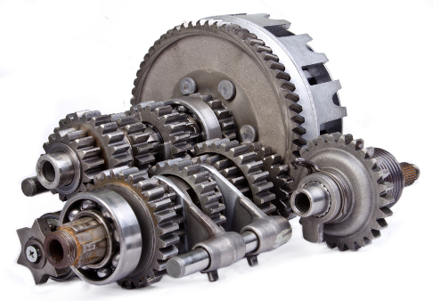
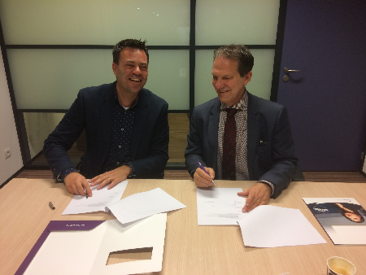
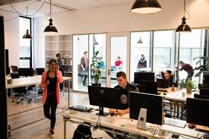
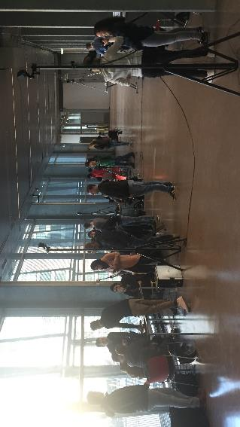
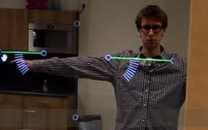
Coach
Peers
Partners In
Education
What
Personal assignments projects & context
Hogeschool ICT
Notes:
#1 Urgentie Hiaat Probleem (Why learn)
#3 Cooperatie interactie en coaching (betekenisvolle dialoog)
#5 Actie en deling (betenisvolle context)

Slide 36


Slide 37
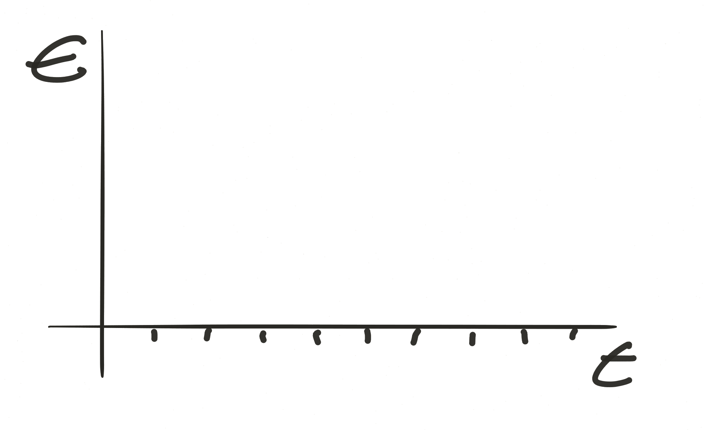
Workload

Slide 38
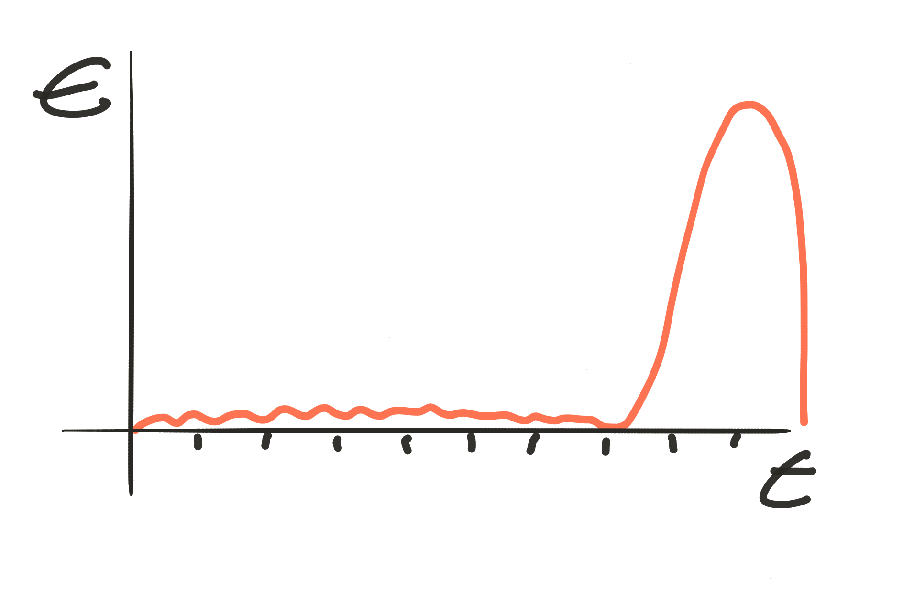
Workload

Slide 39
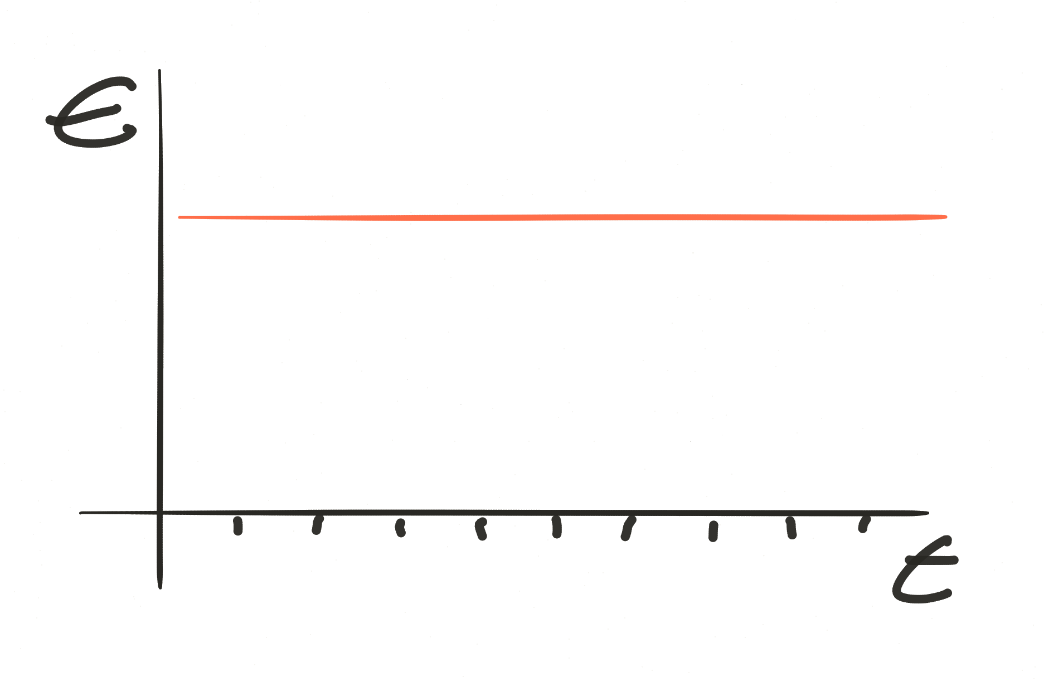
Inspire
Structure
Workflow

Slide 40
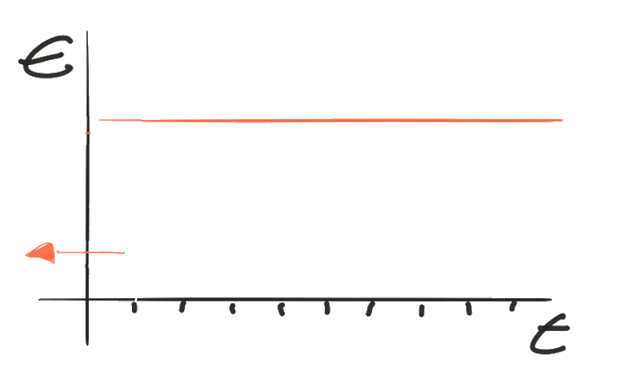
Inspire
Structure
Inspire

Slide 41
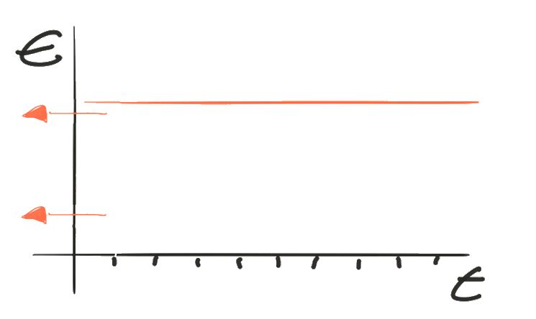
Inspire
Structure
Plan
Inspire

Slide 42
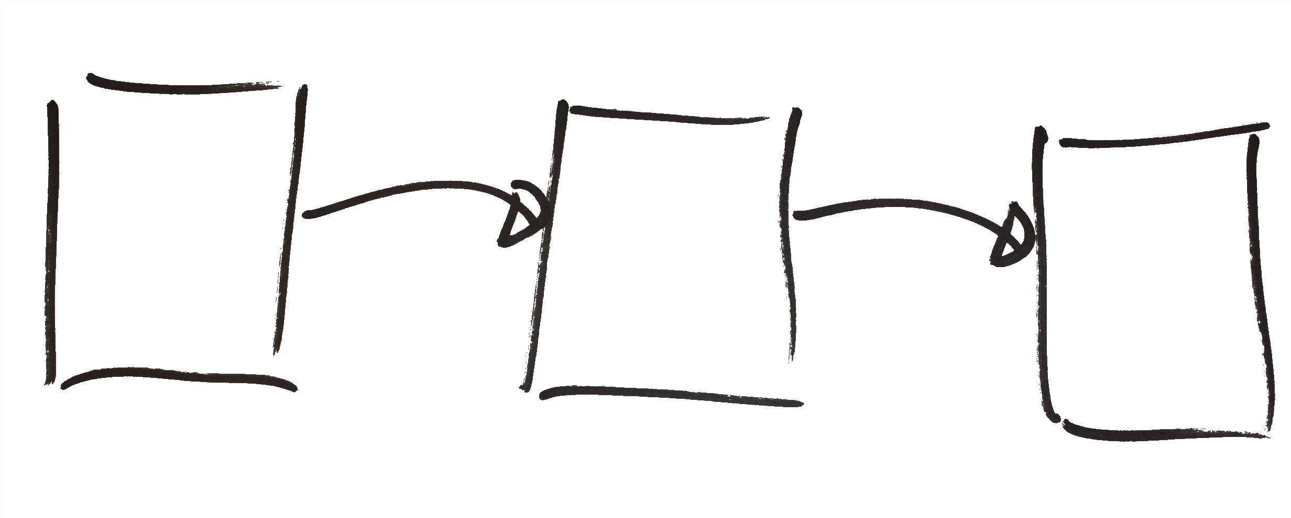
View on content

Slide 43

The C (5.5) dilemma

Slide 44


Well defined basics

Slide 45

Deepening

Slide 46

Contextual freedom
Ownership of content
Challenging

Slide 47

Assessments
How
control how and what
students learn (and plan)
Notes:
#7 Assessment as part of learning (Longitudinaal toetsen)

Slide 48
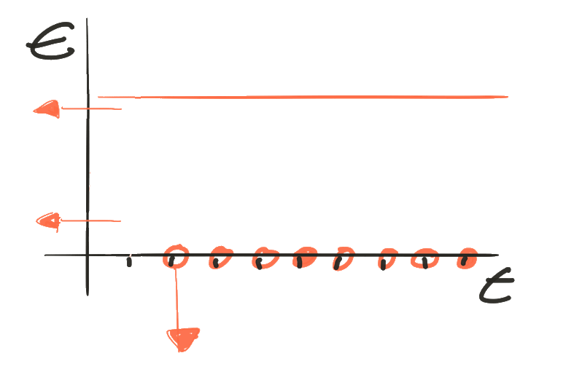

Plan
Inspire
How
Student recorded feedback
Notes:
Gevolg: vierkant rooster. Foto’s lokalen. Betekenis vol les… Eigen niveau

Slide 49
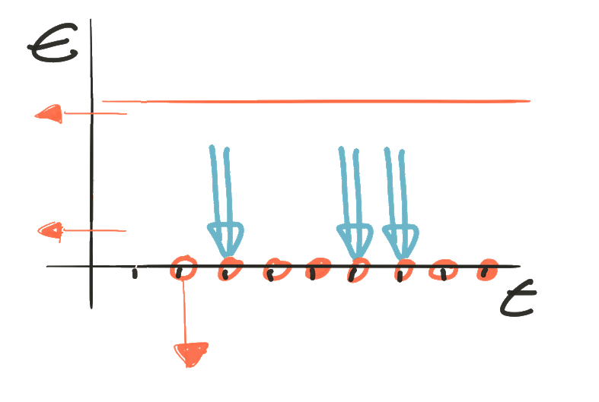

Plan
Recurring assignments
& feedback
Inspire
How
Student recorded feedback
Notes:
Gevolg: vierkant rooster. Foto’s lokalen. Betekenis vol les… Eigen niveau

Slide 50

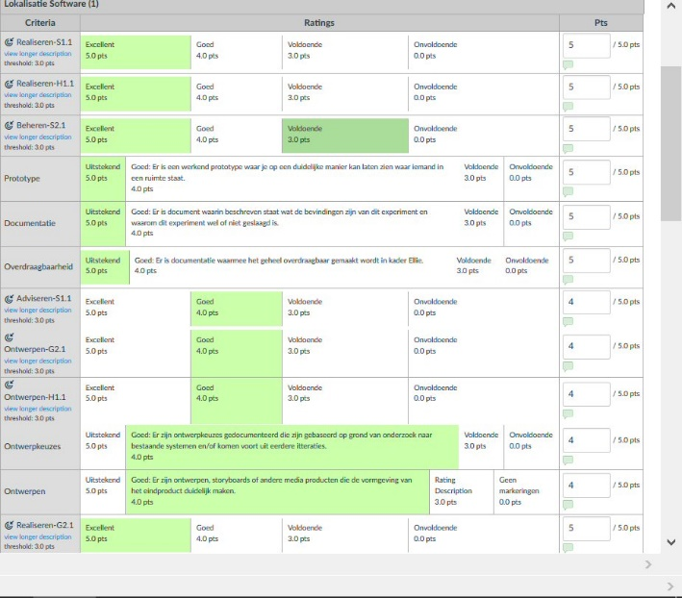
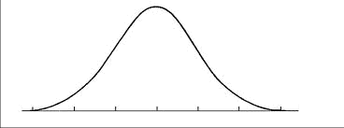
Longitudinal Assessments
Meaningful
Part of the experience
Precise
Notes:
Kennis dossier
Filmpje 4.30

Slide 51
Consequence ?
Notes:
Information as commodity
Self learning
Ownership
#2 Selfmanagement (ownership)
#4 Hybrid learning (Anything goes)
#5 Actie en deling (Betekenisbvolle context, Activated learning)\
#6 Flexibile leerruimte (Felicibility)

Slide 52


Slide 53

Notes:
#2 selfmanagement (Ownership)

Slide 54

Schedules are disruptive for learning!

Slide 55
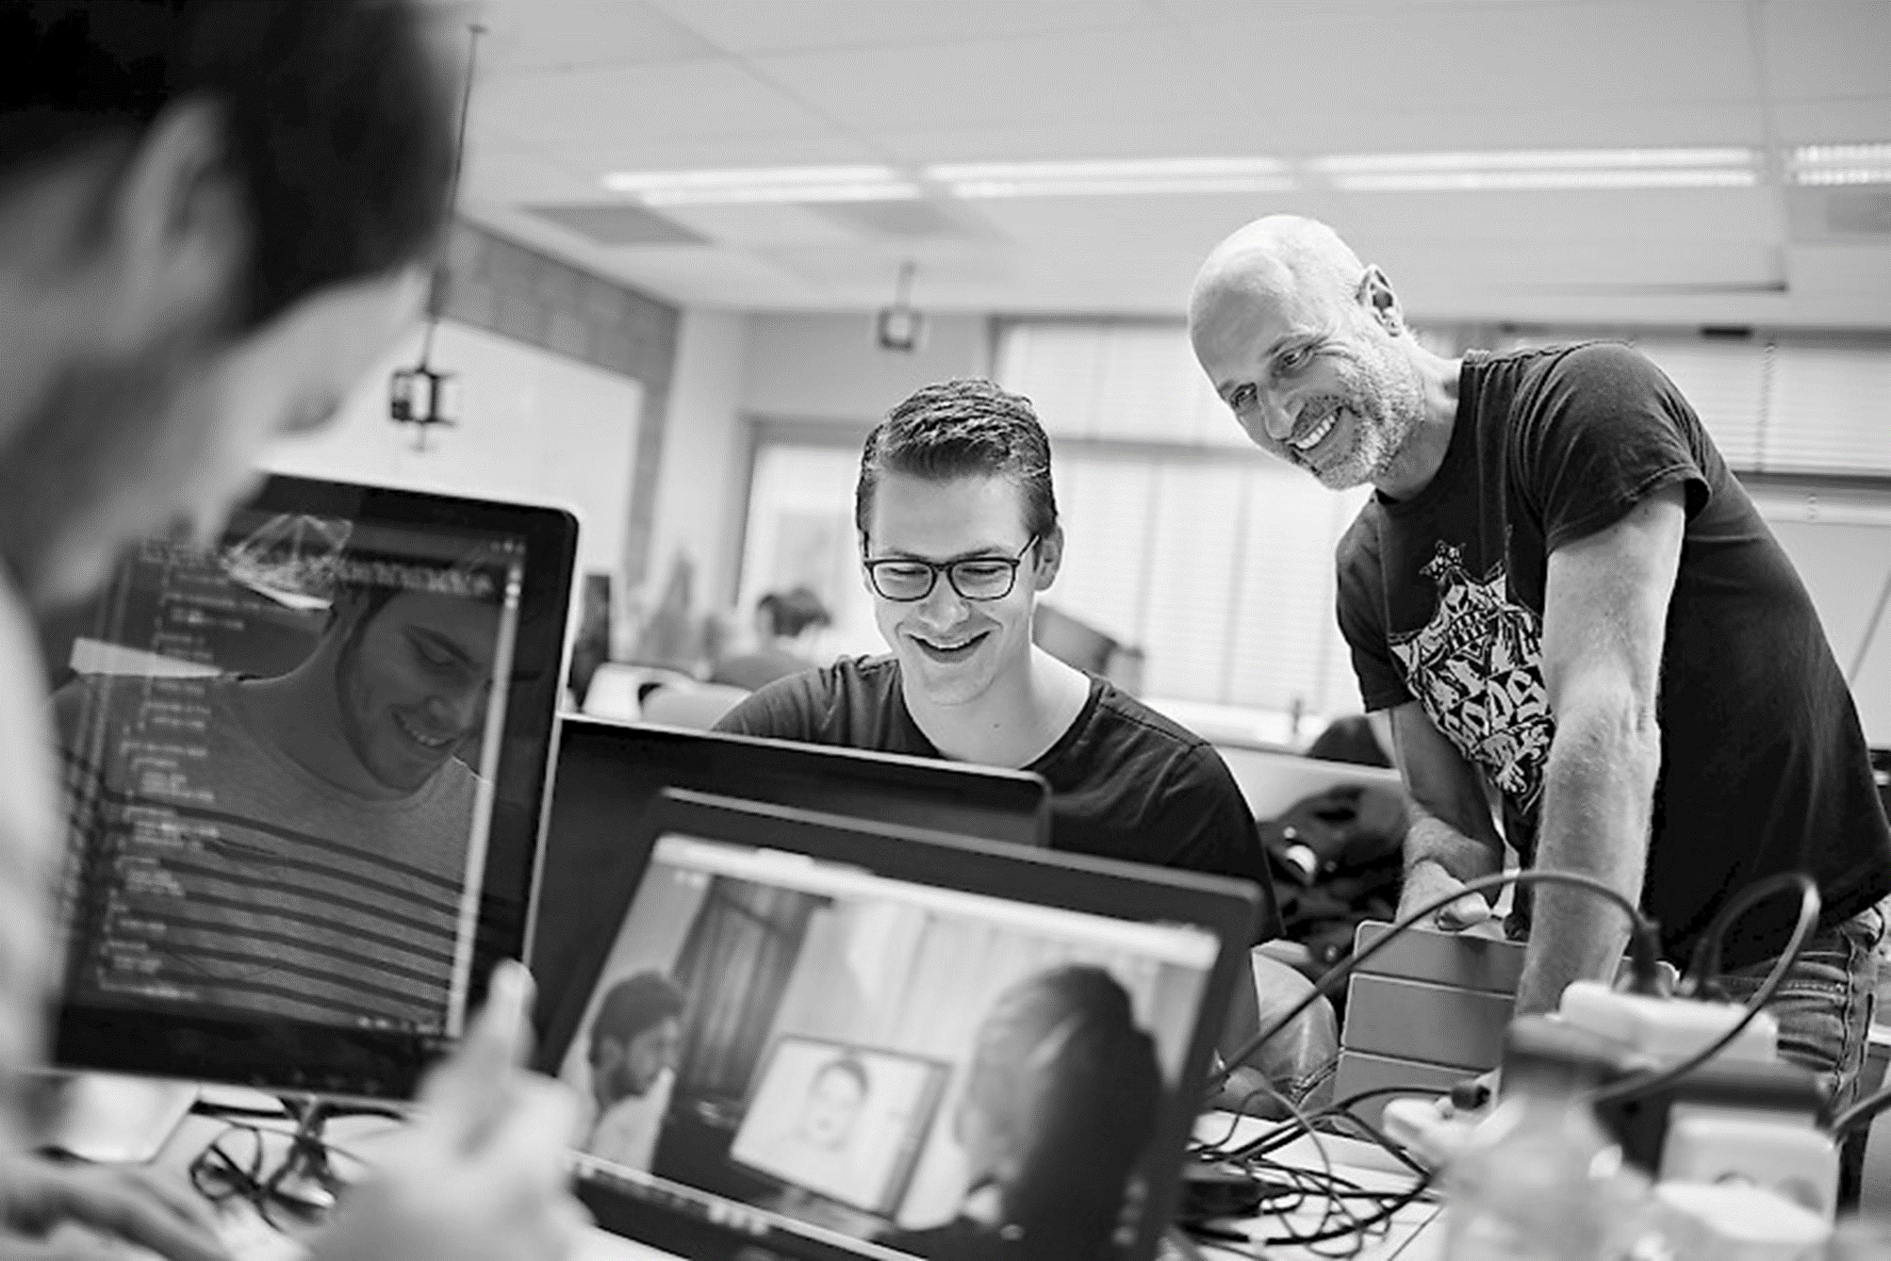

Teaching ?
Notes:
KAL, Betekenisvolle context
#4 Hybrid learning
#3 Cooperation interaction and coaching (Betekenisvolle dialoog en coaching)

Slide 56
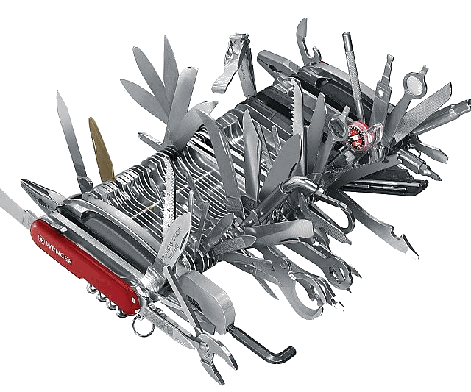
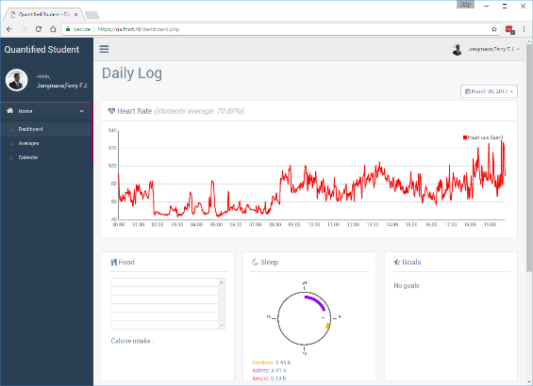
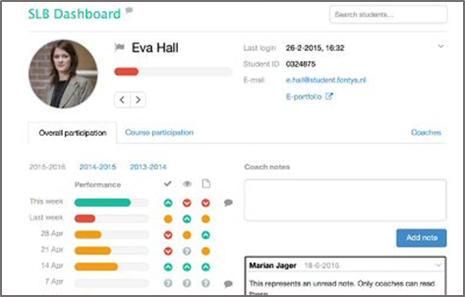
Tooling & Analytics

Slide 57


Slide 58


Slide 59
Some extra information (Youtube links)
K.A.L. approach
Fontys Hogeschool ICT open innovation
Open innovation explained for students
Open innovation choice
Competence framework explained for students
Eric Slaats TED talk about talent driven education
Instructure view on open and Fontys Hogeschool ICT

