Slide 1



@Ericsls
The need for
innovation

Slide 2

Education in context

Slide 3
Speed of change

Slide 4














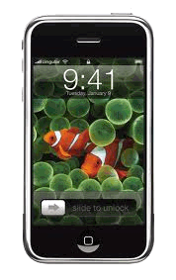














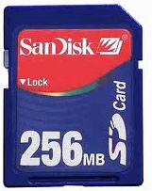



















2002
2004
2006
2008
2010
2012
2014
2015
2016

Slide 5
Permanent state of change

Slide 6
We’re educating into the unknown!

Slide 7

A> Data driven jobs are on the way out!
_

Slide 8


We need responsive professionals!
Adaptive and resilient
Innovative
Responsible

Slide 9
Yesterdays educational system can’t
provide for tomorrows outcomes!

Slide 10



Slide 11

Action!
45 min Session -- Proposition challenge
5 min Present the payoff / punchline
10 min HOW, Good practices about innovation
25 min Session – Create communities, action plan
5 min Present the Monday mission

Slide 12
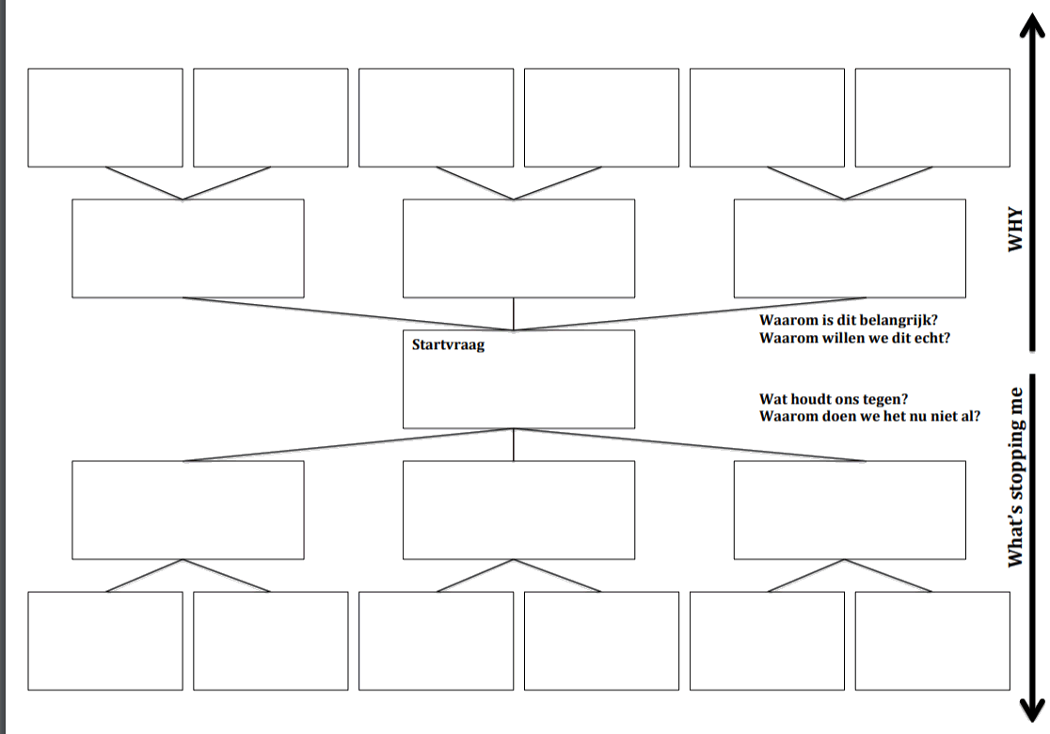

Slide 13

Propositions!
Schedules and lessons distort learning, get rid of them!
Students create their own goals, levels and criteria!
Learning always happens in a social environment: There is no future for distance learning!
The role of the teacher is to facilitate a meaningful dialog, get rid of lessons!
Context is king, a school should be a meaningful environment 23.5/7!
Grades do injustice to the learner and the teacher. Get rid of grades!
Diplomas do injustice to the performance of the individual student!
New world competences should be leading!

Slide 14

Hard to innovate?
Change is
Scary
Messy
Uncomfortable
Painful
Hard work
Swimming against the tide

Slide 15
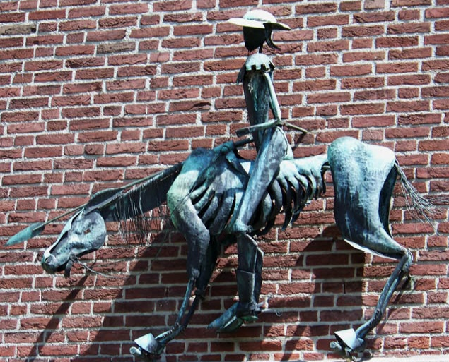
Past the windmills?

Slide 16
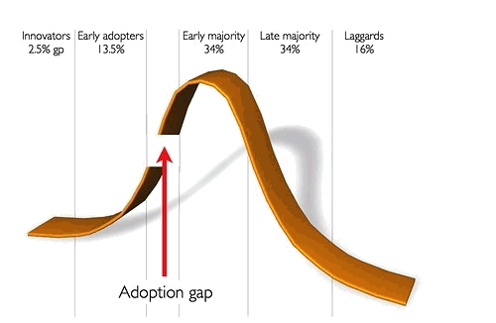
Close the gap!
Innovation in a service oriented organization is hard!

Slide 17

Make it fly
Innovation should
Be painless
Have an obvious “what’s in it for me”
Contextual involvement from he top
Way of working
Only solve occurring problems

Slide 18
Action!
25 min Session – Create communities, action plan
5 min Present the Monday mission

